Slide 1
GEOSpatial data analysis of oyo state using location data

Slide 2
introduction
Location data is used to solve hard problems—from providing firefighters and emergency medical technicians key information during times of human crisis, helping us avoid bad traffic
We are in an era of big data and with more devices, the amount of data generated will keep increasing, data will be more accessible than ever before and location data will become more accurate.

Slide 3
Significance of the study
This study will be of great benefit to entrepreneurs, government and other parastatals who might want to start up something significant.
Exploring the city will give insights into where a business could be situated given the large state it is.
It could also help bridge the gaps between customers and producers, government and citizens as decision making will be made easier with the study.

Slide 4
DATA ACQUISITION
The data used for this project was sourced from the Oyo state website, oyostate.gov.ng. The data features were local government, the headquarters where the local government is situated, date of creation of the local government, total number of wards in the local government, area population from 2006 census and landmass of the local government

Slide 6
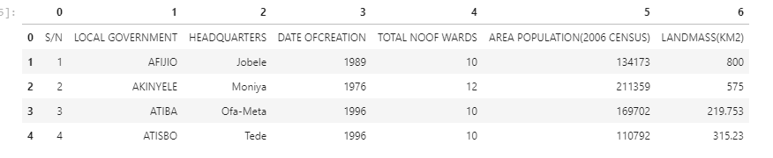
Data extraction and exploratory data analysis
Table of the first five local government extracted from the Oyo state website

Slide 7
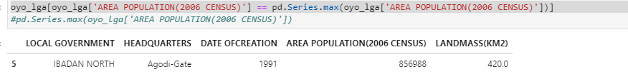
Local government area with the highest population and with the lowest population with code

Slide 8
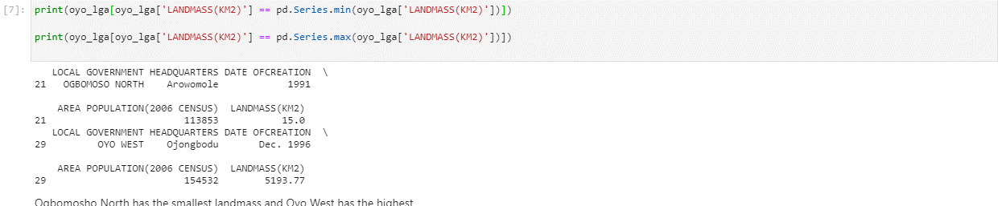
Local government area with the most landmass and with the least landmass

Slide 9
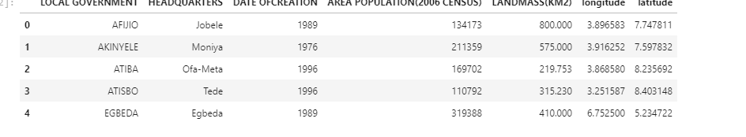
First five local government area with their respective latitude and longitude generated using Nominat module in geopy package

Slide 10
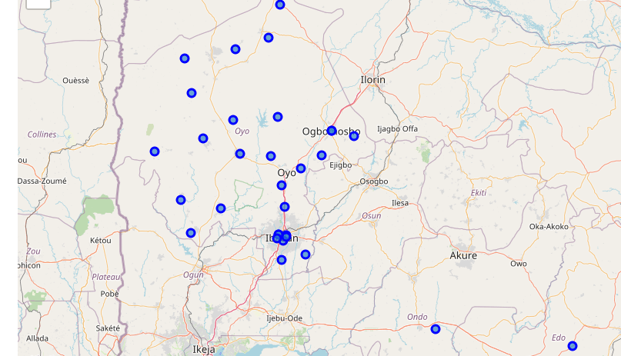
Map of oyo with the lga superimposed

Slide 11
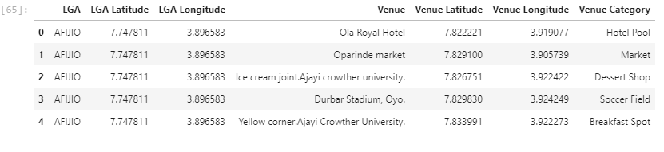
First five venue and venue category gotten using the Foursquare API

Slide 12
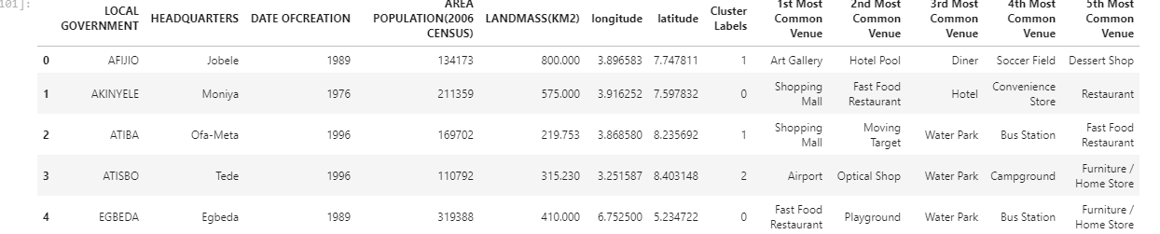
Table showing the top five venues for each local government (First five)

Slide 13
Clustering algorithm analysis
Unsupervised machine learning algorithm called K-mean algorithm was applied to the top five venue locations and three clusters were used.
The cluster was explained as follows:
Cluster one can be named a set of local government area where reception services, restaurants and relaxations centres are highly concentrated and consist mostly local government area in Ibadan.

Slide 14
Clustering analysis continue
Cluster two can be named a set of local government area where sport centre and recreational centres are located. All local government in this cluster except Iseyin, which itself is close to Oyo West local government were in this cluster
Cluster three tends to be a commercial area because of the presence of airport in the two returned local government area.

Slide 15
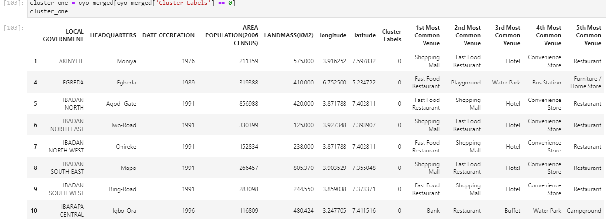
Cluster 1:

Slide 16
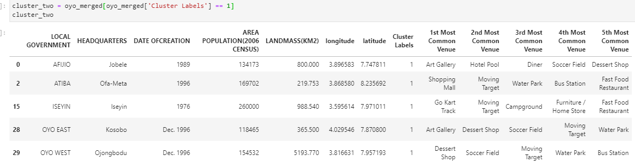
Cluster 2:

Slide 17
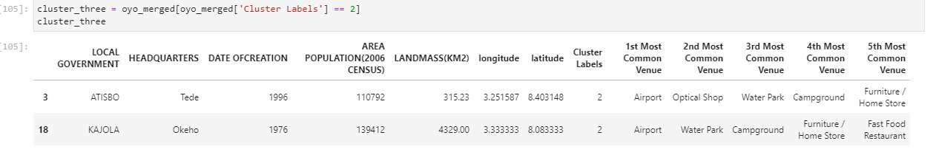
Cluster 3:

Slide 18
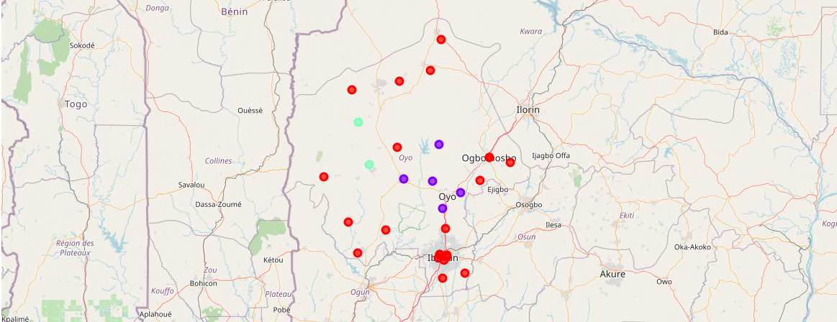
Visualization of the clusters

Slide 19
Conclusion
From my analysis of the local government in Oyo state, I was able to conclude that Oyo state has low level of socialization and industrialization. It makes it a convenient and resourceful place to situate business, industries, recreation centres, restaurants and shops and many more.
This study was performed to gain insights about how location data of Oyo state can be used to achieve great feat in decision making; from entrepreneurs to government. This study was not an official study and there are still room for many analyses to explore.

Slide 20
references
https://www.factual.com/blog/location-data-solves-tough-problems/
The Challenges Facing Location Data & Location Intelligence In 2020 – James Ewen; https://www.tamoco.com/blog/the-challenges-facing-location-data-location-intelligence-in-2019/
https://www.linkedin.com/pulse/housing-sales-prices-venues-data-analysis-ofistanbul-sercan-y%C4%B1ld%C4%B1z/
https://www.ibm.com/developerworks/library/os-foursquare/index.html
https://oyostate.gov.ng/ministry-of-local-government-and-chieftaincy-matters/detailed-information-of-the-33-local-governments-in-brief/
https://en.wikipedia.org/wiki/Oyo_State

Slide 21
THANK YOU!

